Slide 1
19ECE204
Lecture 6&7

Slide 2
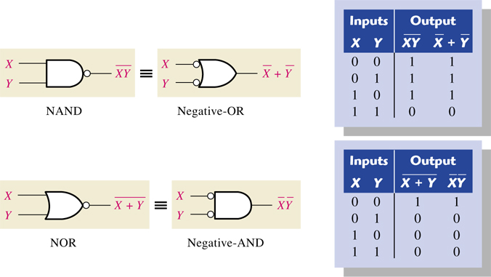
NAND and NOR Logic Networks, XOR Gates
obtained by complementing the outputs of AND and OR operations
These functions are implemented with simpler electronic circuits than the AND and OR functions
DeMorgan’s Theorem
(A • B)’ = A’ + B’ and (A + B)’ = A’ • B’
DeMorgan’s theorem will help to simplify digital circuits using NORs and NANDs.

Slide 3
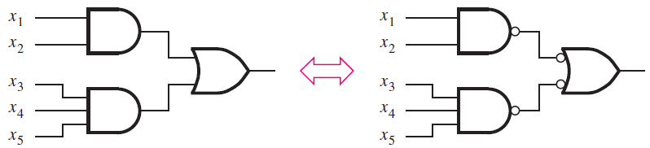
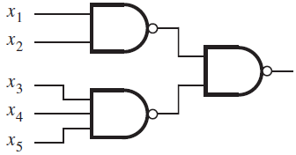

Contd.
Sum-of-products or product-of-sums form, will have networks that have either an AND-OR or an OR-AND structure, respectively.
These networks can be implemented using only NAND gates or only NOR gates.
AND-OR implemented using only NAND gates.

Slide 4
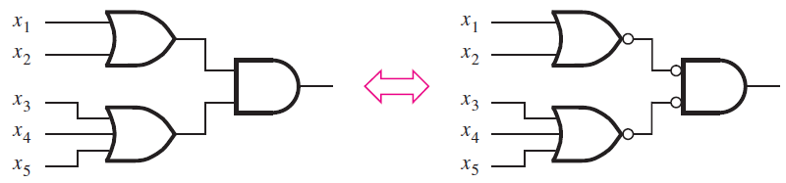
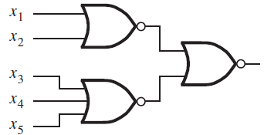
Using NOR gates to implement a product-of-sums
OR-AND network can be implemented as a NOR-NOR network

Slide 5
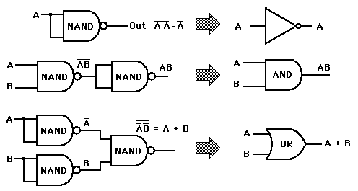
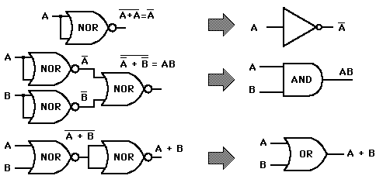
Universal Gates
NAND and NOR Gates are also called as Universal Gates because AND, OR and NOT gates can be implemented using these gates.
NAND Gate Implementations of other gates
NOR Gate Implementations of other gates

Slide 6
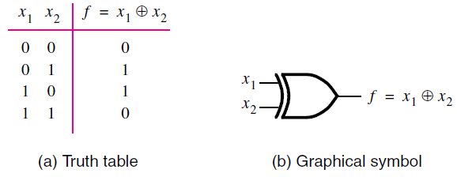
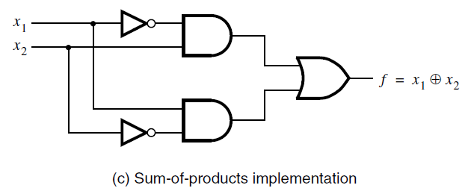
XOR Gate
The XOR operation is usually denoted with the ⊕ symbol.
It can be realized in the SOP form as,
Truth table
& symbol are,
SOP realization

Slide 7
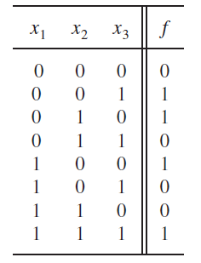


Problem: Assume that a large room has three doors and that a switch near each door controls a light in the room. It has to be possible to turn the light on or off by changing the state of any one of the switches.
Light ON if exactly any 1 switch closed & OFF is a second switch also closed.
But if a 3rd switch also closed then light is ON.
Let x₁, x₂ , x₃ be the input variables that denote the state of each switch.
And f(x₁, x₂ , x₃) represents the state of the light,
Then SOP form is
And POS form is

Slide 8
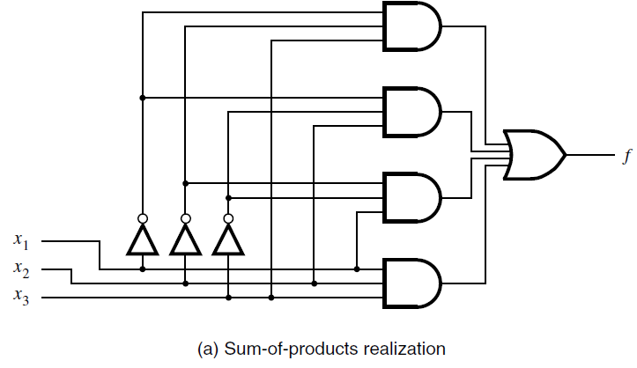
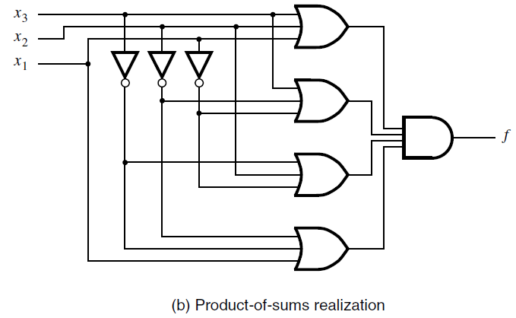

Slide 9
Introduction to Karnaugh Map (K-Map)
Simplification methods used in logical networks are:
Boolean algebra (algebraic method) – tedious and difficult to simplify
Karnaugh map (map method)
Quine-McCluskey(tabular method)
Karnaugh map - provides a systematic way of producing a minimum-cost logic expression.
The key to the K-map approach is that it allows the application of the combining property easily.
It is also an alternative to the truth-table form for representing a function.

Slide 10
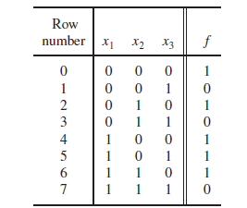
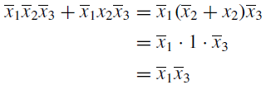
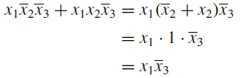
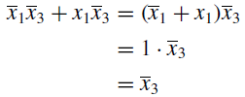
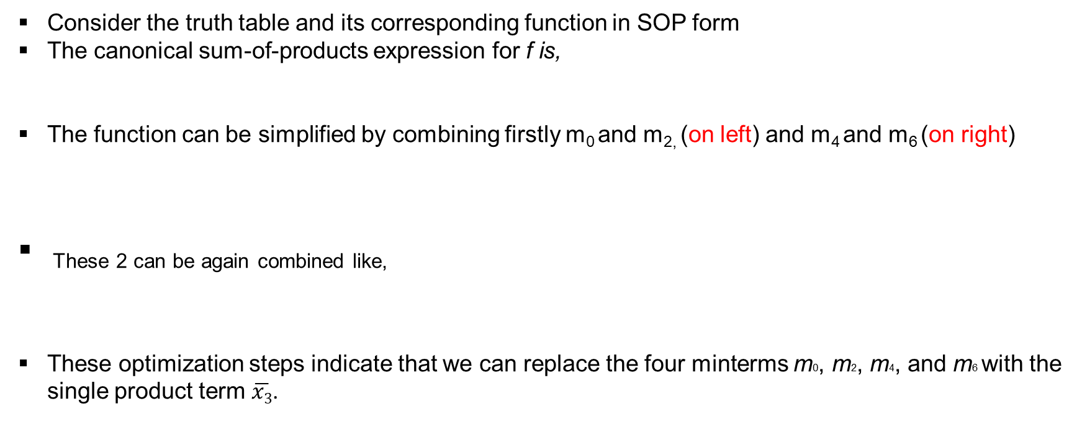
Contd..
Consider the truth table and its corresponding function in SOP form
The canonical sum-of-products expression for f is,
The function can be simplified by combining firstly m₀ and m_{2,} (on left) and m₄ and m₆ (on right)
These 2 can be again combined like,
These optimization steps indicate that we can replace the four minterms m0, m2, m4, and m6 with the single product term $\overline{x3}$.

Slide 11
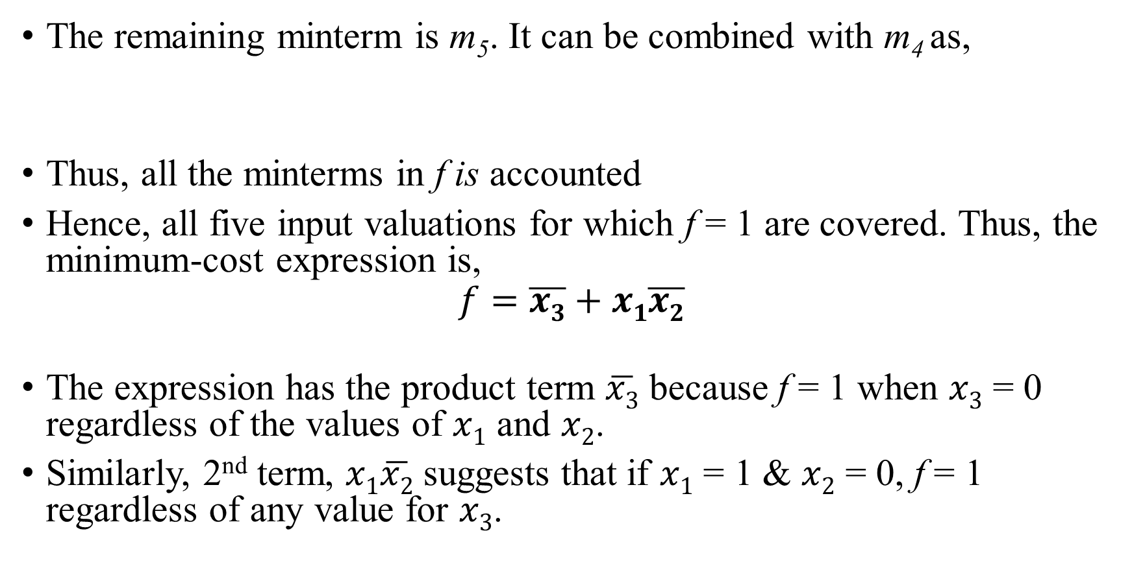
Contd..
The remaining minterm is m₅. It can be combined with m₄ as,
Thus, all the minterms in f is accounted
Hence, all five input valuations for which f = 1 are covered. Thus, the minimum-cost expression is,
$$f=\overline{x3}+x1\overline{x2}$$
The expression has the product term $\overline{x3}$ because f = 1 when $x3$ = 0 regardless of the values of $x1$ and $x2$.
Similarly, 2nd term, $x1\overline{x2}$ suggests that if $x1$ = 1 & $x2$ = 0, f = 1 regardless of any value for $x3$.

Slide 12
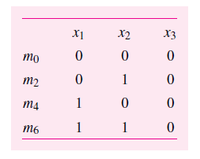
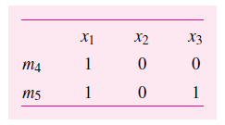
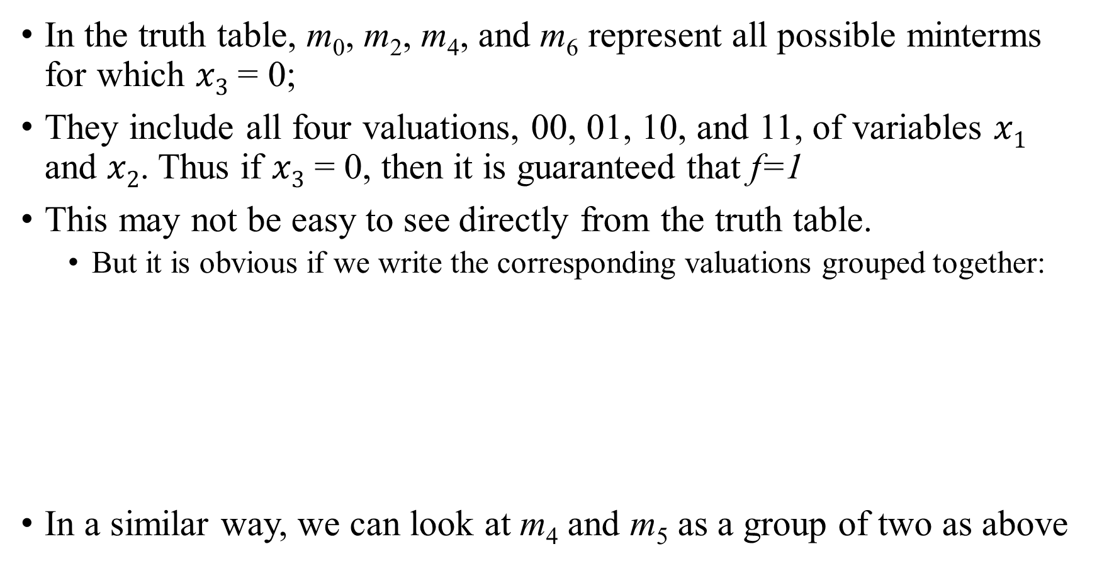
Contd..
In the truth table, m₀, m₂, m₄, and m₆ represent all possible minterms for which $x3$ = 0;
They include all four valuations, 00, 01, 10, and 11, of variables $x1$ and $x2$. Thus if $x3$ = 0, then it is guaranteed that f=1
This may not be easy to see directly from the truth table.
But it is obvious if we write the corresponding valuations grouped together:
In a similar way, we can look at m₄ and m₅ as a group of two as above

Slide 13
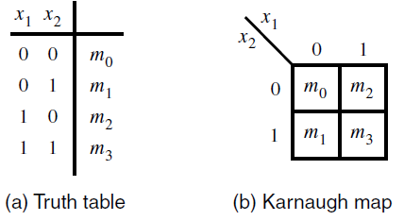
Contd..
So, we need a method which allows easy discovery of groups of minterms for which f = 1 such that they can be combined easily.
Karnaugh map (K Map) is such a method.
It is also an alternative to the truth-table form for representing a function.
K map consists of cells that correspond to the rows of the truth table.
Minterms in any two cells that are adjacent, either in the same row or the same column, can be combined.

Slide 14
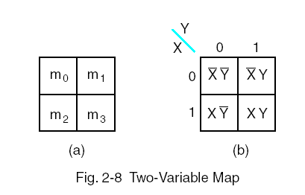
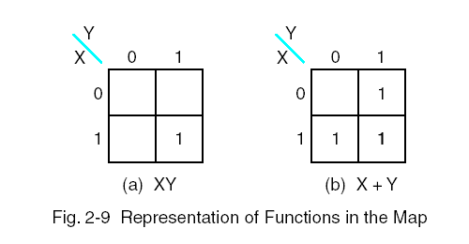
Karnaugh Map (K- Map) Steps
Sketch a Karnaugh map grid for the given problem in power of 2^{N} Squares
N is number of variables
Fill in the 1’s and 0’s from the truth table of SOP or POS Boolean function
For SOP, circle groups of 1’s.
Circle the largest groups of 2, 4, 8, etc. first.
Minimize the number of circles but make sure that every 1 is in a circle.
Write an equation using these circles.
XY+XY′=X(Y+Y′)=X

Slide 15
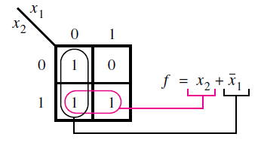
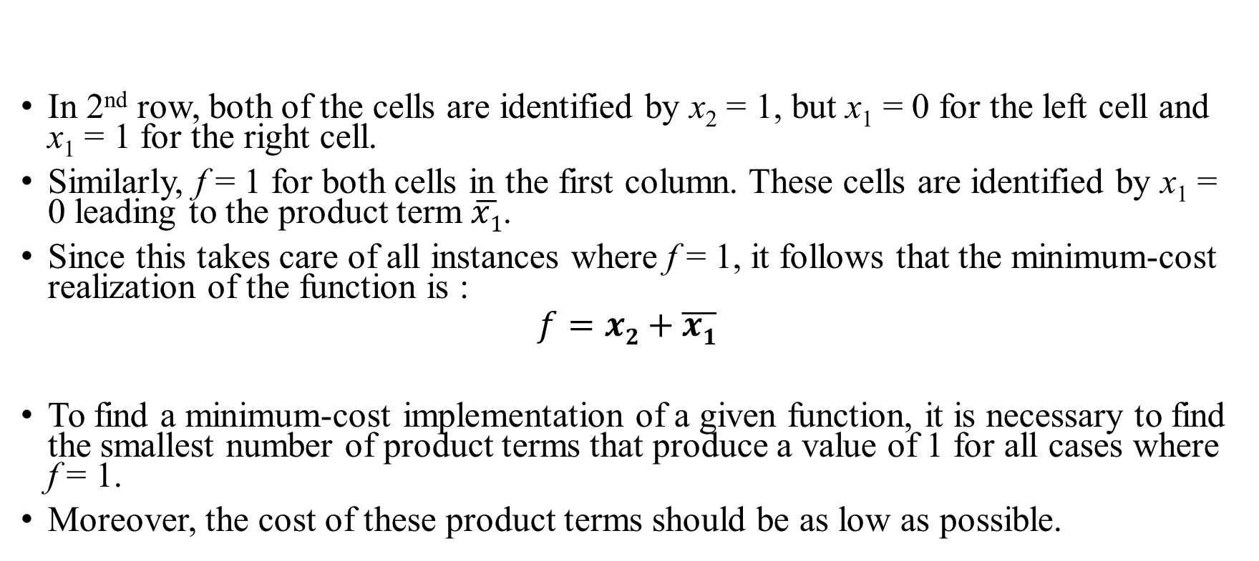
2 variable Map
In 2nd row, both of the cells are identified by x₂ = 1, but x₁ = 0 for the left cell and x₁ = 1 for the right cell.
Similarly, f = 1 for both cells in the first column. These cells are identified by x₁ = 0 leading to the product term $\overline{x1}$.
Since this takes care of all instances where f = 1, it follows that the minimum-cost realization of the function is :
$$f=x2+\overline{x1}$$
To find a minimum-cost implementation of a given function, it is necessary to find the smallest number of product terms that produce a value of 1 for all cases where f = 1.
Moreover, the cost of these product terms should be as low as possible.

Slide 16
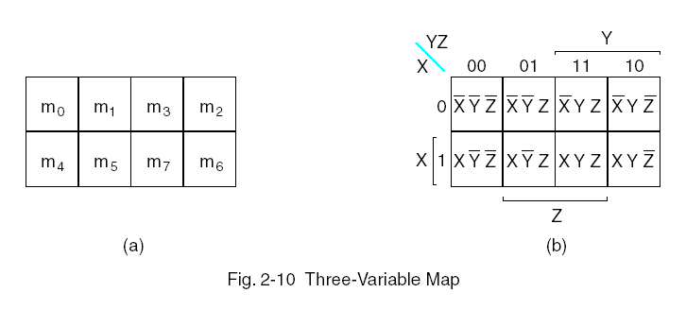
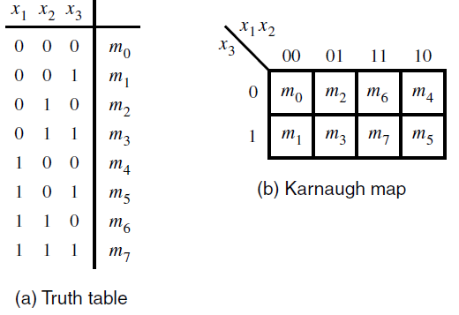
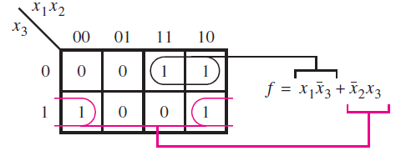
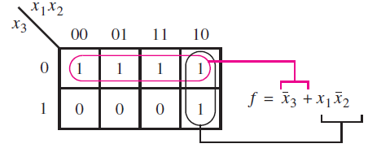
3 variable map
Gray code
The map should be visualised as a rectangle folded into a cylinder where the left and the right edges are made to touch

